Slide 1




Electrical Behavior Prediction Of An Inverter Using Machine Learning Algorithms
Gabriel Lima Jacinto, Mateus Grellert, Cristina Meinhardt
Universidade Federal de Santa Catarina

Slide 2

Structure
Introduction
Algorithms
Methodology
Results
Conclusion
Context
The Problem
Goal
Multiple Linear Regression
Decision Tree
Random Forest
Support Vector Regression
Performance Measurements
Scaling
Feature Extraction
Workflow
TPHL
TPLH
IINT
Best Algorithm
Worst Algorithm
Future Works
Model Deployment

Slide 3
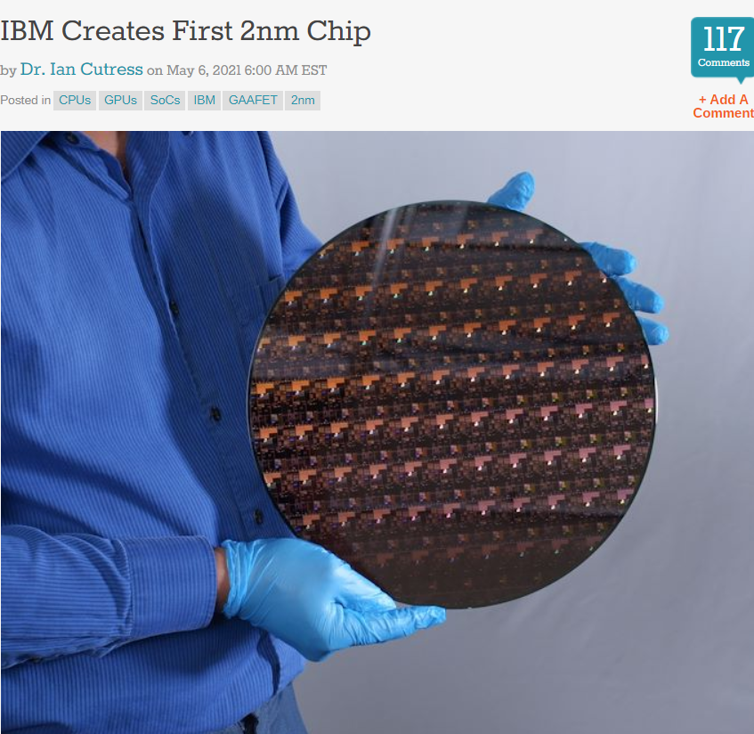
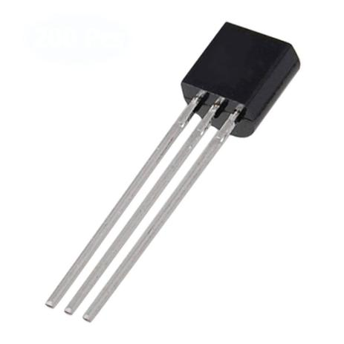
Context
Introduction
Algorithms
Methodology
Results
Conclusion

Slide 4
The Problem
Introduction
Algorithms
Methodology
Results
Conclusion
Technology Complexity
Design Process Variability
Affects
Delay
Power Consumption
Machine Learning
Thus, reducing cost of production
Possible Solution
Simulations
(can take very long)
In order to avoid
More corner cases must be considered during the electrical characterization
Machine learning can assist digital design in many levels

Slide 5
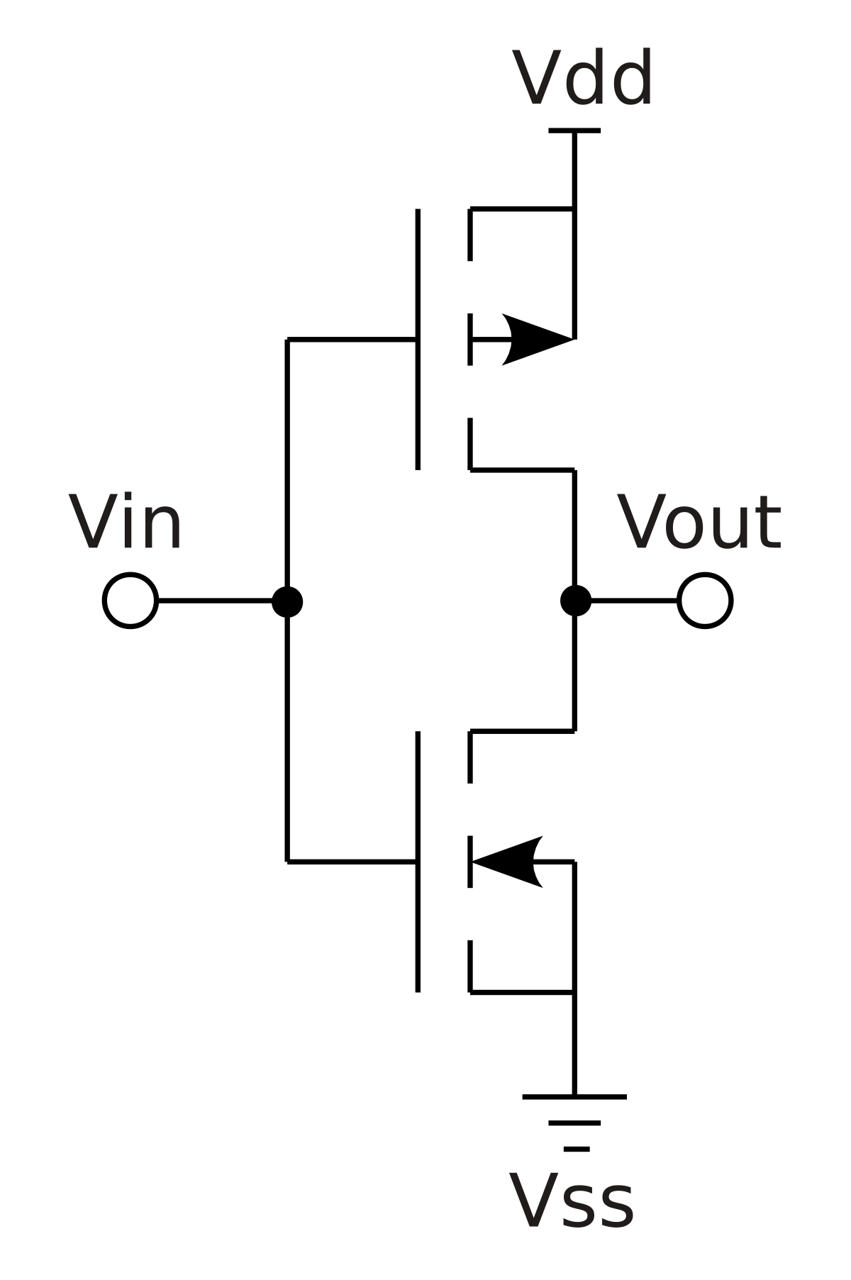






Goal
Regression Task!
Introduction
Algorithms
Methodology
Results
Conclusion
CMOS INVERTER CIRCUIT
SUPERVISED ALGORITHMS
DEPENDENT VARIABLES
MACHINE LEARNING MODELS
PREDICTION
Tp_{L}H
SIMULATION DATA
Multiple Linear Regression
Tp_{H}L
(temperature, voltage, process variability...)
Support Vector Regression
Decision Trees
Random Forest
Energy
https://pt.wikipedia.org/wiki/CMOS

Slide 6
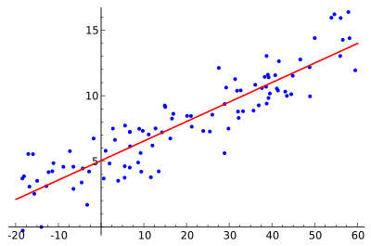

Multiple Linear Regression (MLR)
Introduction
Algorithms
Methodology
Results
Conclusion

Slide 7
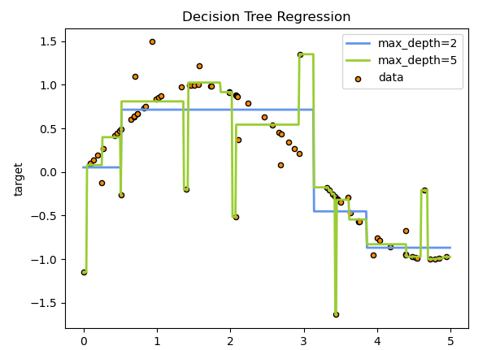
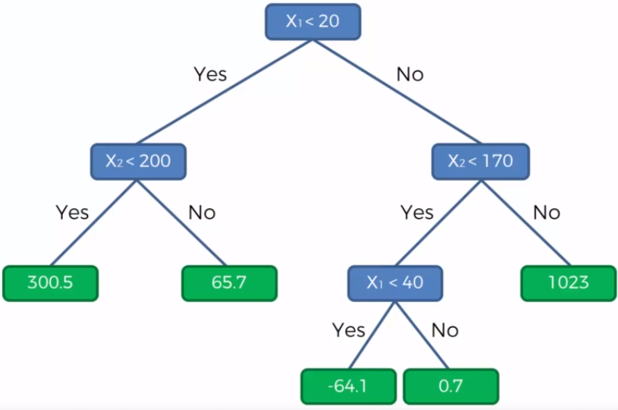
Decision Tree
Introduction
Algorithms
Methodology
Results
Conclusion

Slide 8
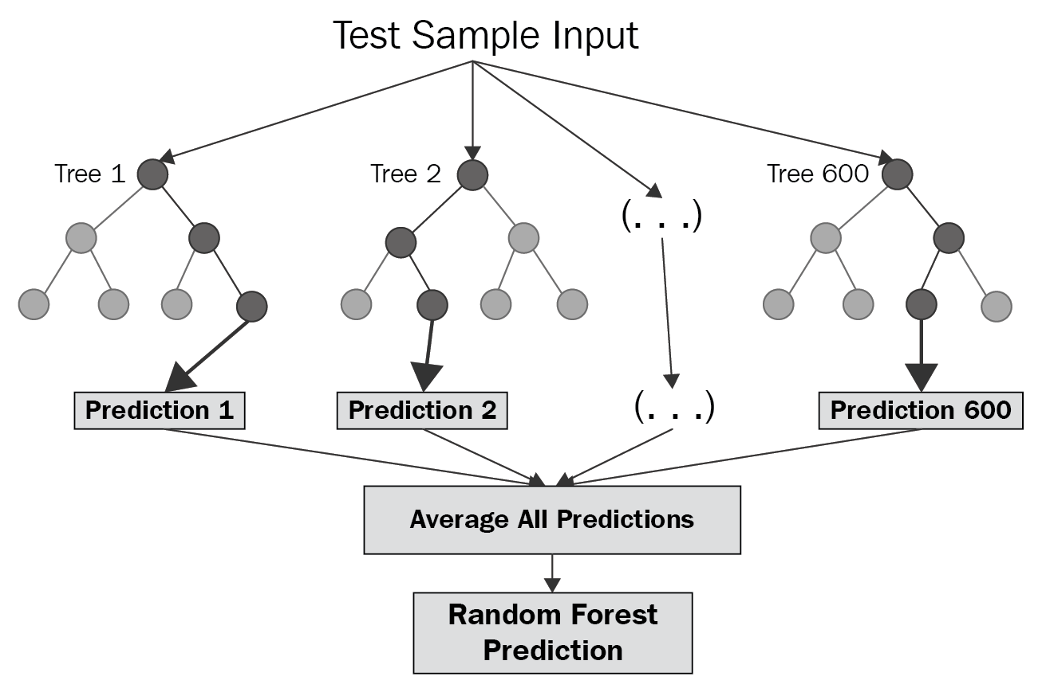
Random Forest
Introduction
Algorithms
Methodology
Results
Conclusion

Slide 9
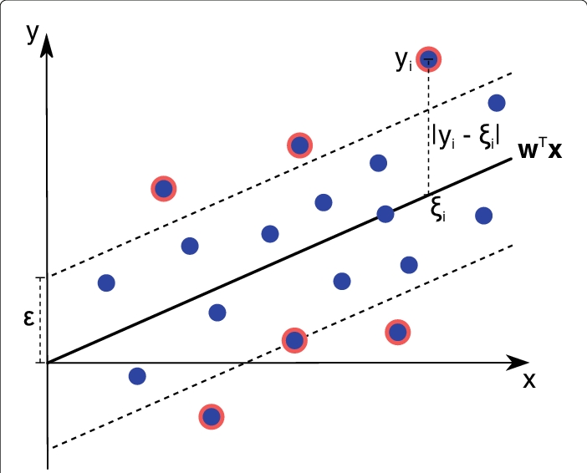
Support Vector Regression
Introduction
Algorithms
Methodology
Results
Conclusion
ŷ = 𝒘^{𝐓}𝒙 + b

Slide 10

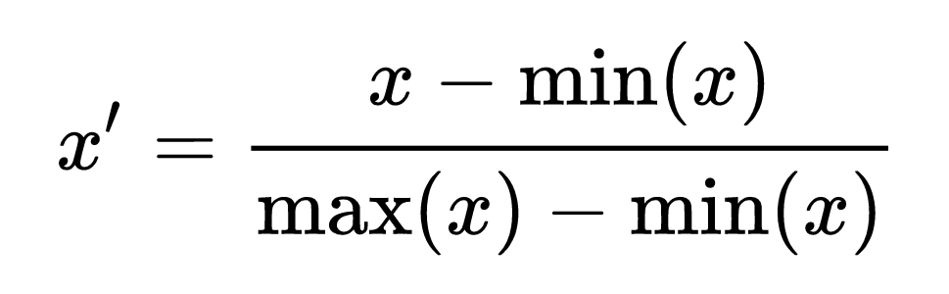
Performance Measurement
Root Mean Square Error (RMSE)
Scaling
MIN-MAX Scaler
Introduction
Algorithms
Methodology
Results
Conclusion

Slide 11
Feature Extraction
Features
Targets
Introduction
Algorithms
Methodology
Results
Conclusion
1000 Monte Carlo transient simulations of 20ns with step of 0.1ns in HSPICE
Algorithms trained using cross-validation
NMOS Vth0
PMOS Vth0
Temperature (-25, 0, 50, 75, 100°C)
Voltage (0.6, 0.7, 0.8, 0.9V)
Width PMOS (70, 140, 280, 350, 420nm)
Width NMOS (70, 140nm)
Length (20, 32, 40nm)
High-Low Propagation (TPHL)
Low-High Propagation (TPLH)
Energy (IINT)

Slide 12
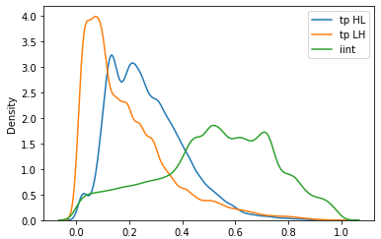
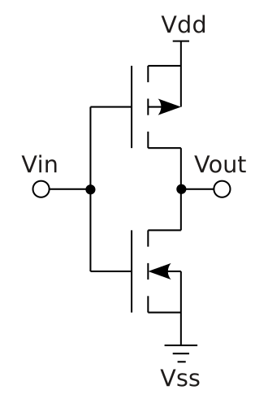
Workflow
Introduction
Algorithms
Methodology
Results
Conclusion
I. Simulation
II. Targets
III. Data Processing
IV. Algorithms
50%
Training Set
Multiple Linear Regression
Support Vector Machine
Decision Trees
Random Forest
Energy
TPHL
TPLH
Min-Max Scaler
25%
Validation Set
II. Features
Voltage
Temperature
Width PMOS
Width NMOS
Length
Nmos Vth0
Pmos Vth0
25%
Test Set
V. Evaluation
VI. Results
VII. Model Deployment
References

Slide 13
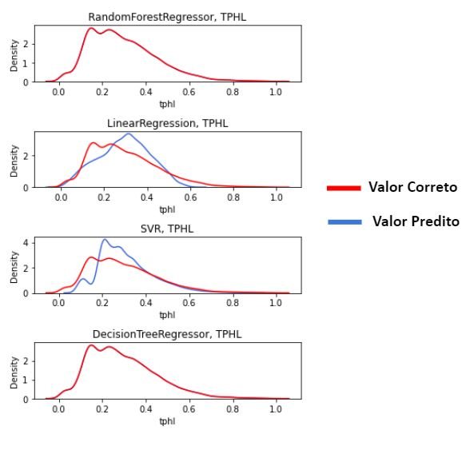
TPHL Prediction
RMSE = 0.003245
RMSE = 0.059929
RMSE = 0.095629
RMSE = 0.003760
Introduction
Algorithms
Methodology
Results
Conclusion
Correct Output
Predicted Output

Slide 14
Normalized Distribution
Introduction
Algorithms
Methodology
Results
Conclusion

Slide 15
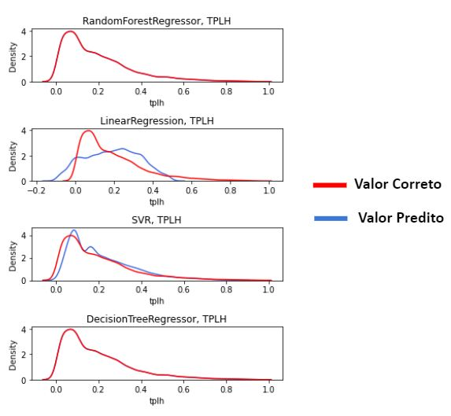
TPLH Prediction
RMSE = 0.002793
RMSE = 0.054531
RMSE = 0.082220
RMSE = 0.003446
Introduction
Algorithms
Methodology
Results
Conclusion
Correct Output
Predicted Output

Slide 16
Normalized Distribution
Introduction
Algorithms
Methodology
Results
Conclusion

Slide 17
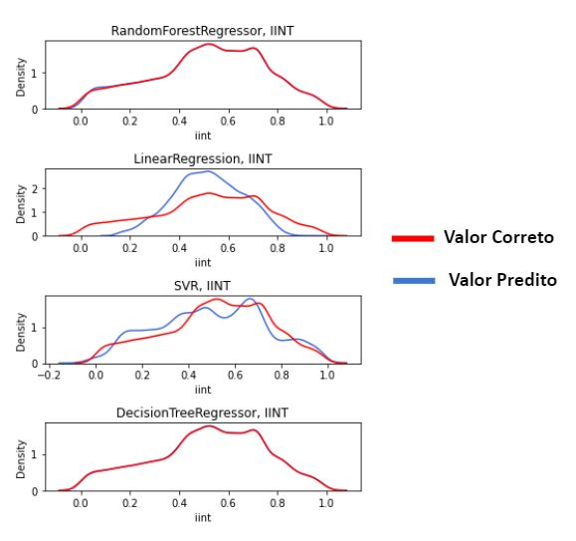
Energy Prediction
RMSE = 0.010312
RMSE = 0.056865
RMSE = 0.177822
RMSE = 0.013450
Introduction
Algorithms
Methodology
Results
Conclusion
Correct Output
Predicted Output

Slide 18
Best Algorithm
Random Forest
Worst Algorithm
Multiple Linear Regression
Future Works
Introduction
Algorithms
Methodology
Results
Conclusion
Future steps include to explore other gates (XOR) and technologies as FINFET.

Slide 19
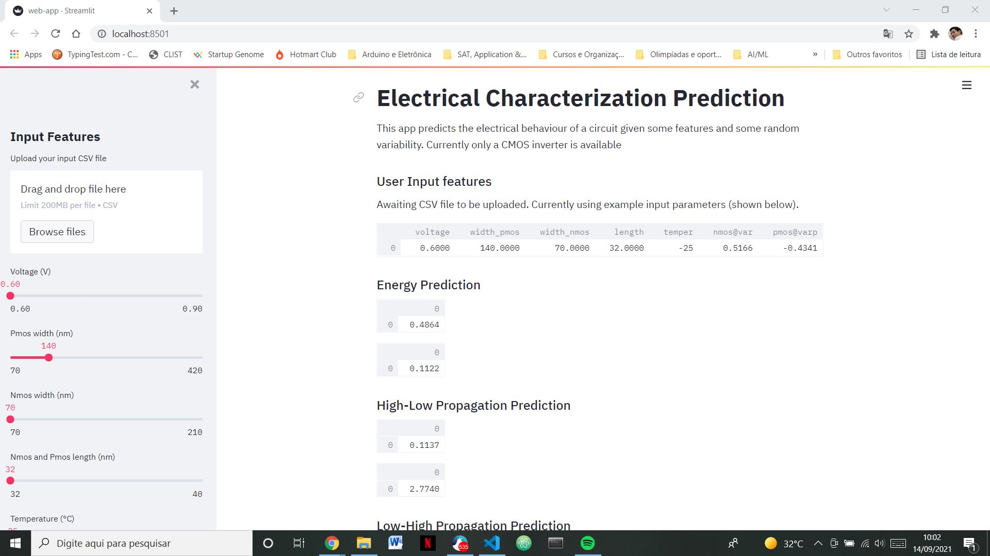

Model Deployment
Introduction
Algorithms
Methodology
Results
Conclusion

Slide 20
Electrical Behavior Prediction Of An Inverter Using Machine Learning Algorithms
gabriellimajacinto@gmail.com
Gabriel Lima Jacinto, Mateus Grellert, Cristina Meinhardt
Universidade Federal de Santa Catarina

Slide 21
Appendix
Cross-Validation Values
Best Hyperparameters
DT - Max Depth: 1, 5, 10, 25, 50
RF - Max Depth: 1, 5, 10, 25, 50
RF - N Estimators: 5, 25, 50, 100, 150
SVR - Gamma: 0.03125, 0.0625, 0.125, 0.25, 4
SVR - C: 0.25, 0.5, 1, 2, 10
 | DT - Max Depth | RF - Max Depth | RF - N Estimators
TPHL | 5 | 5 | 25
TPLH | 10 | 10 | 150
IINT | 10 | 10 | 150

Slide 22
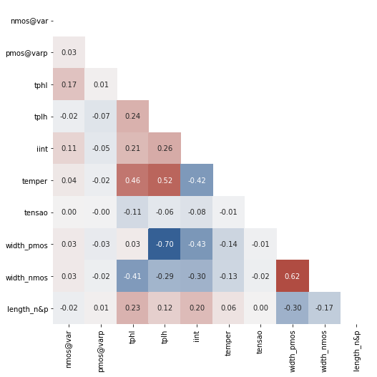
Appendix
Pearson Correlation Coefficients

Slide 24
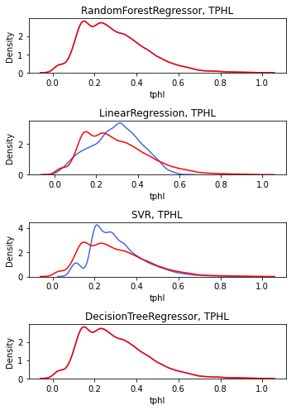
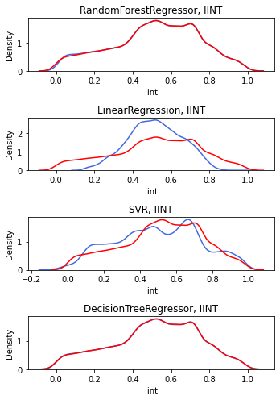
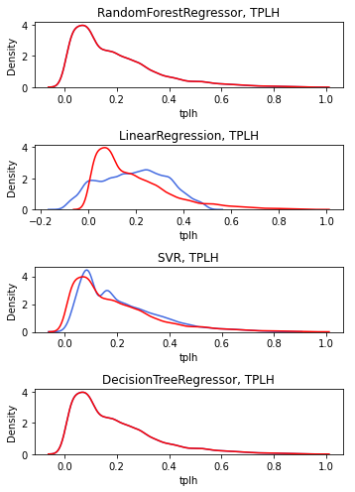
Correct Output
Correct Output
Correct Output
Predicted Output
Predicted Output
Predicted Output

Slide 25
Correct Output
Correct Output
Correct Output
Predicted Output
Predicted Output
Predicted Output

